Slide 1
My Growth YU He, T RDA IOT INW-CN
siemens.com
Restricted © Siemens AG 2020

Slide 2




Keep on growing
Growth Path：
2020 ~
Easy to use, easy to integrate industry Collaborative IoT solutions
Low effort and threshold building blocks for digital business
Outlook
2017--2020
Projects: End-to-end IoT projects
Device condition monitoring
- Schaeffler (DF PL CAS)
- THVS (SE GP T NP BIC THVS)
DaaS (Maintenance Service)
- SAIC VW, FAW-VW (DI CS SFAE FA-SO)
- WaterWheelStation Digital (RC-CN DI S-RE SE&TSS)
Device reverse control based on cloud
- SmartWaterManagement (DI CS DE&DS CAS)
Innovation Topics:
Low-effort Engineering
- Data Feeding Module
- MindSphere VSCode Plugin
Resource and performance optimization
- CloudSim
- Easy to use edge computing tools
Innovation Projects
2015--2017
Cloud + Automation
MindKnowledge Project
BU : DI SW CAS (MindSphere HQ)
Training for MindSphere R&D CN Setup
BU: DI SW CAS
Consulting for MindSphere Domestic Solution
BU: DI SW GS&CS AP CN, DI DE
Support from colleagues and families

Slide 3
Keep on growing
Growth Path：
2020 ~
Easy to use, easy to integrate industry Collaborative IoT solutions
Low effort and threshold building blocks for digital business
Outlook
2017--2020
Projects: End-to-end IoT projects
Device condition monitoring
- Schaeffler (DF PL CAS)
- THVS (SE GP T NP BIC THVS)
DaaS (Maintenance Service)
- SAIC VW, FAW-VW (DI CS SFAE FA-SO)
- WaterWheelStation Digital (RC-CN DI S-RE SE&TSS)
Device reverse control based on cloud
- SmartWaterManagement (DI CS DE&DS CAS)
Innovation Topics:
Low-effort Engineering
- Data Feeding Module
- MindSphere VSCode Plugin
Resource and performance optimization
- CloudSim
- Easy to use edge computing
Innovation Projects
2015--2017
Cloud + Automation
MindKnowledge Project
BU : DI SW CAS (MindSphere HQ)
Training for MindSphere R&D CN Setup
BU: DI SW CAS
Consulting for MindSphere Domestic Solution
BU: DI SW GS&CS AP CN, DI DE
MindSphere
Support from colleagues and families

Slide 4
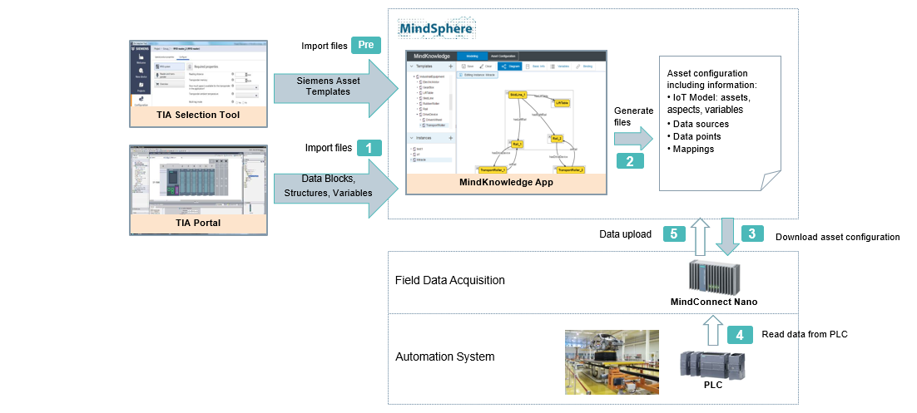
MindKnowledge Template management and TIA Portal assisted asset onboarding
Background
Customer: DF PL CAS (MindSphere HQ)
Target:
- Customer want to build as much as differentiators, such as Siemens specific solutions including typical Siemens software e.g. TIA Portal.
- Customer want to provide easy to use tools and fast building method for engineers and app developers, to race with competitors.
Solution
MindKnowledge provides device template management including creating, importing, editing templates. Templates can be used for building new models.
Support TIA Portal files import and understanding, and introduce an easier way of asset configuration, by providing variable selection instead of manually input.
Workflow：
Benefit

Slide 5
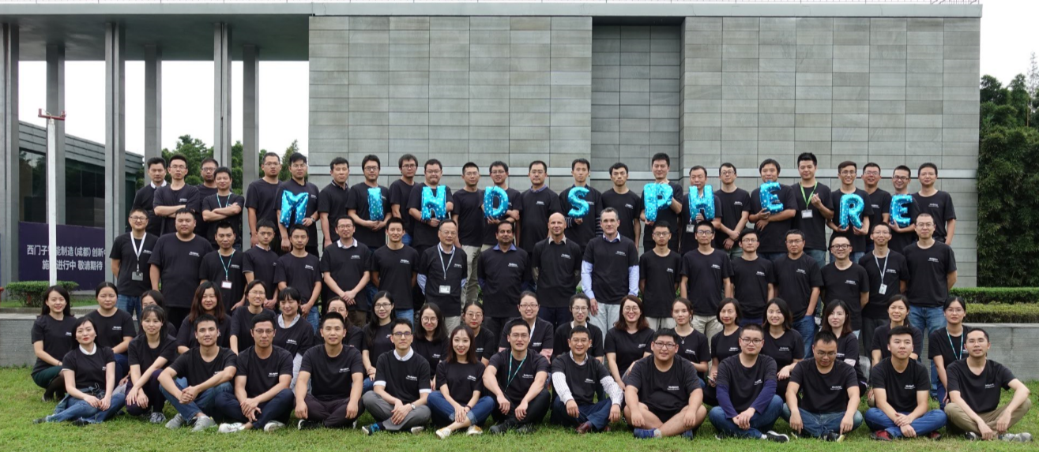
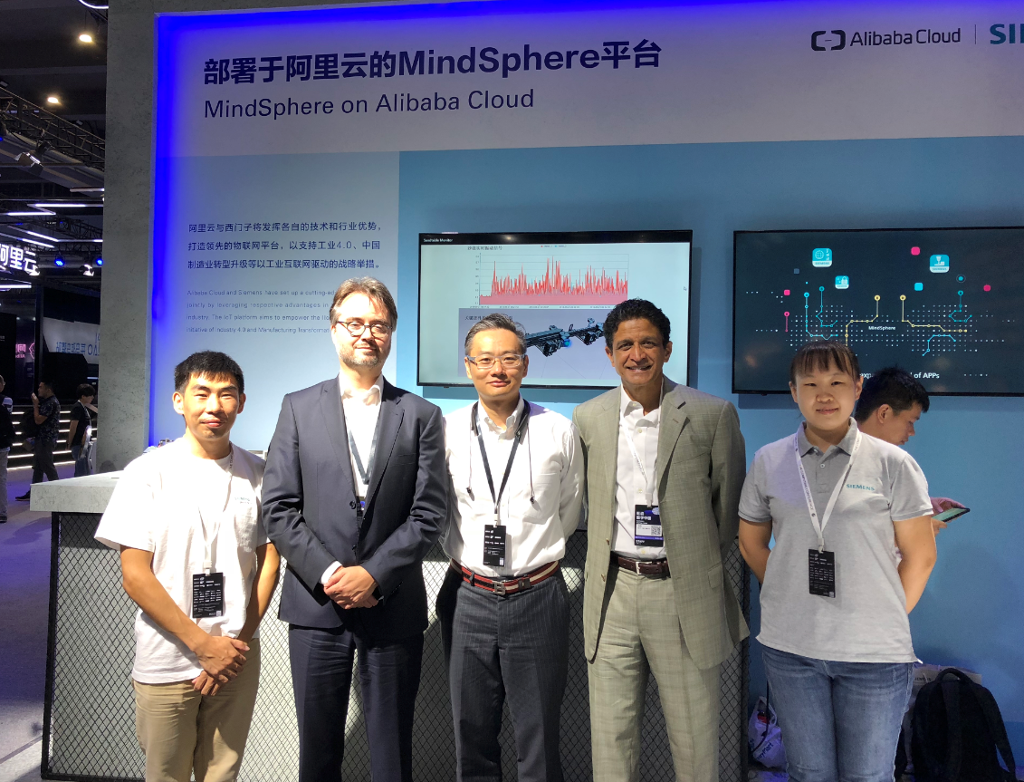
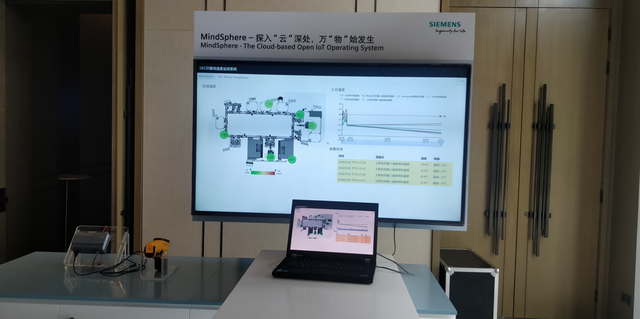
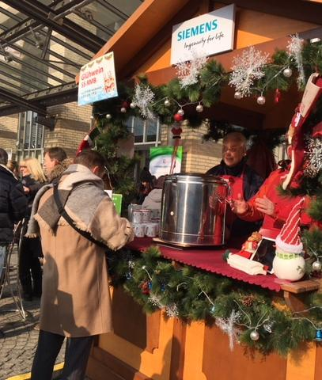
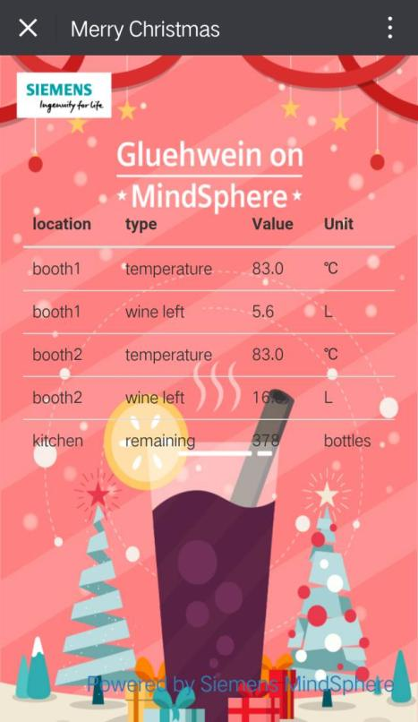
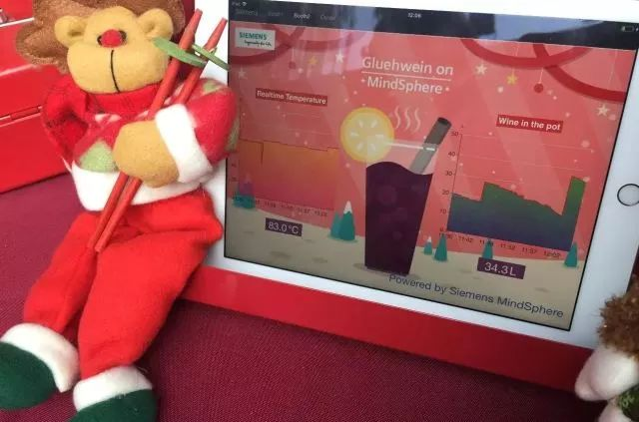
MindKnowledge Benefits and Impacts
Benefits & Impacts for Customer
For end customer, asset onboarding process becomes much easier. For MindSphere, TIA Portal is integrated to the platform, asset onboarding becomes easier and the method of device template management has been provided a reference.
Benefits & Impacts for CT
Understand MindSphere architecture and details Accumulate the competitiveness of cloud solutions. Established the trust and cooperation with related BU.
MindSphere Training
BU : DI SW CAS (MindSphere R&D)
Ali YunQi Conference
BU : DI DE (MindSphere Sales)
IFS ,DEC Demo Show
BU : DI CS DE
WineSphere
Siemens Christmas Market Booth
Show digitalization concept to external

Slide 6
Keep on growing
Growth Path：
2020 ~
Easy to use, easy to integrate industry Collaborative IoT solutions
Low effort and threshold building blocks for digital business
Outlook
2017--2020
Projects: End-to-end IoT projects
Device condition monitoring
- Schaeffler (DF PL CAS)
- THVS (SE GP T NP BIC THVS)
Maintenance Service
- DaaS (DI CS SFAE FA-SO)
- WaterWheelStation Digital (RC-CN DI S-RE SE&TSS)
Device reverse control based on cloud
- SmartWaterManagement (DI CS DE&DS CAS)
Innovation Topics:
Low-effort Engineering
- Data Feeding Module
- MindSphere VSCode Plugin
Resource and performance optimization
- CloudSim
- Easy to use edge computing
Innovation Projects
2015--2017
Cloud + Automation
MindKnowledge Project
BU : DI SW CAS (MindSphere HQ)
Training for MindSphere R&D CN Setup
BU: DI SW CAS
Consulting for MindSphere Domestic Solution
BU: DI SW GS&CS AP CN, DI DE
MindSphere
Support from colleagues and families

Slide 7
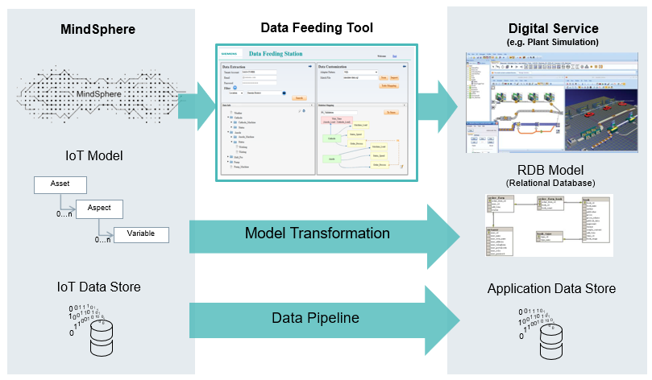
Data Feeding Closing the gap between digital service and cloud
Existing Question
Knowledge gap between cloud platform and app development.
Existed service/application deployment and migration maintenance effort cost.
Recode effort of app modification to fit requirement change
Solution
DataFeeding Tool (app) provides model mapping between cloud timeseries data and relation structure of application’s db.
Integrate the data pipeline for data subscribe to mapped database.
Easy operation interface to save the effort of engineer/developer work.
Workflow：
Benefit

Slide 8

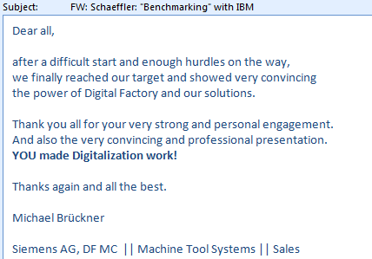
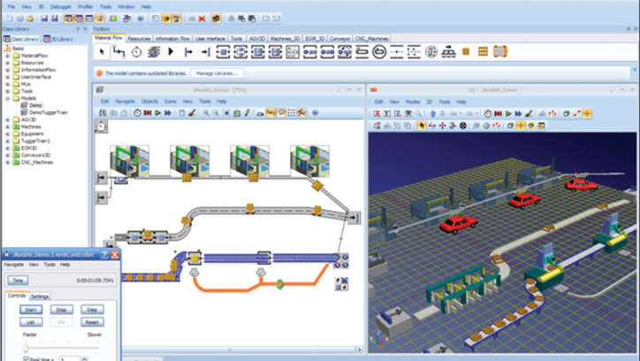
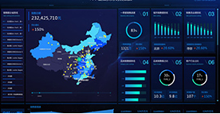
Data Feeding Business improvement in three main aspects
Quickly Application Development
UseCase: Schaeffler Project Schaeffler Germany factory need to guarantee their OEE and finding cloud solution. MindSphere HQ is competing with IBM on this project, need to provide multi-type machine tools system or other IT system. At that time, the native application is poor for customer. Reuse the existed local version OEE module, and make it as a MindApp by data feeding
Accelerate Digital Business Integration
Cross-platform or system Interaction
UseCase: Interaction with external application deployed on Aliyun Aliyun provide the service DataV for quick big screen visualization. MindSphere provide the industry edge connectivity competence. Data feeding makes the timeseries data to Aliyun RDS to support the existed visualization application. Formed technical ecosystem.
UseCase: PlantSimulation closed-loop service based on cloud
PlantSimulation (Simulation SW of Siemens) having the simulation data, the case want to use the real data to validate the simulation design (e.g. rationality of station cycle).
The topic/direction is how to quickly integrate Siemens PL product.
Combining simulation data and real-timeseries data by data feeding to PlantSimulation local database.
Support projects, such as THVS, DaaS and WaterWheelMachine, etc..

Slide 9
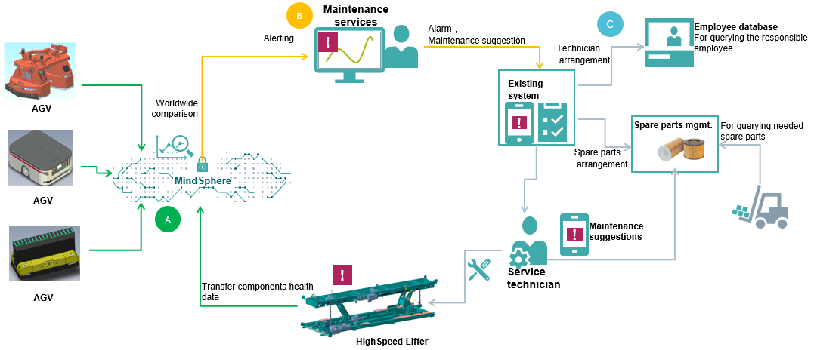
Device as a Service Siemens maintenance solution in automotive industry
Background
Customer: DI CS SFAE FA-SO, Factory Automation Solution.
Main Product: Assembly technology & systems in automotive industry
Target:
- Create new business on automotive digitalization industry.
- Market-driven cooperation with partner.
- Provide Siemens maintenance solution in automotive industry.
Solution
DaaS provides the maintenance service packages, incl data acquisition and edge computing, maintenance service and system exchange as the standard portfolios.
Framework for cloud and local solution.
Edge computing scheme with FEMA analysis to enrich competitiveness in domain.
Workflow：

Slide 10
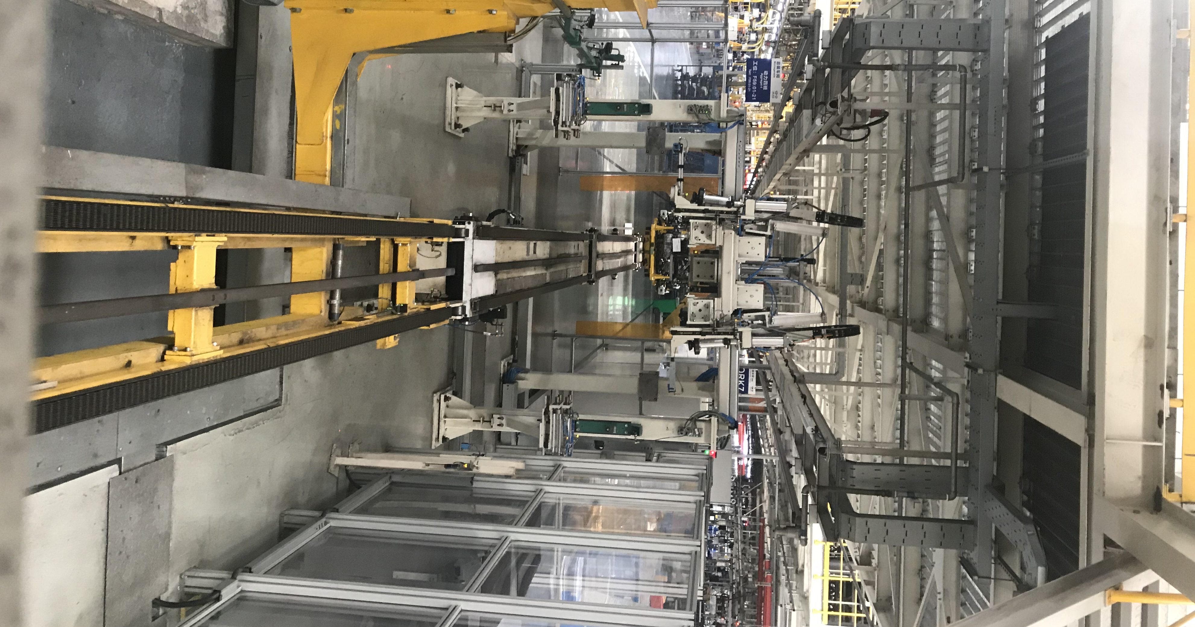
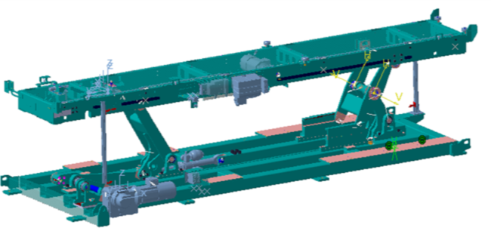
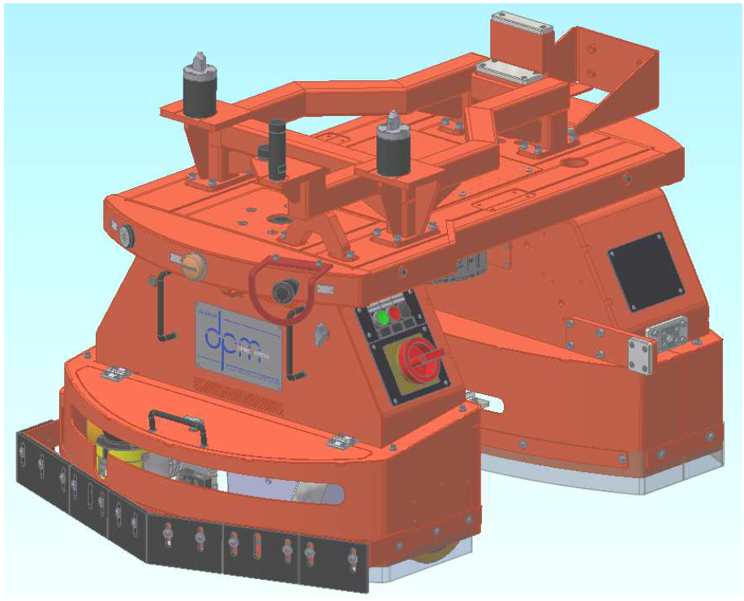
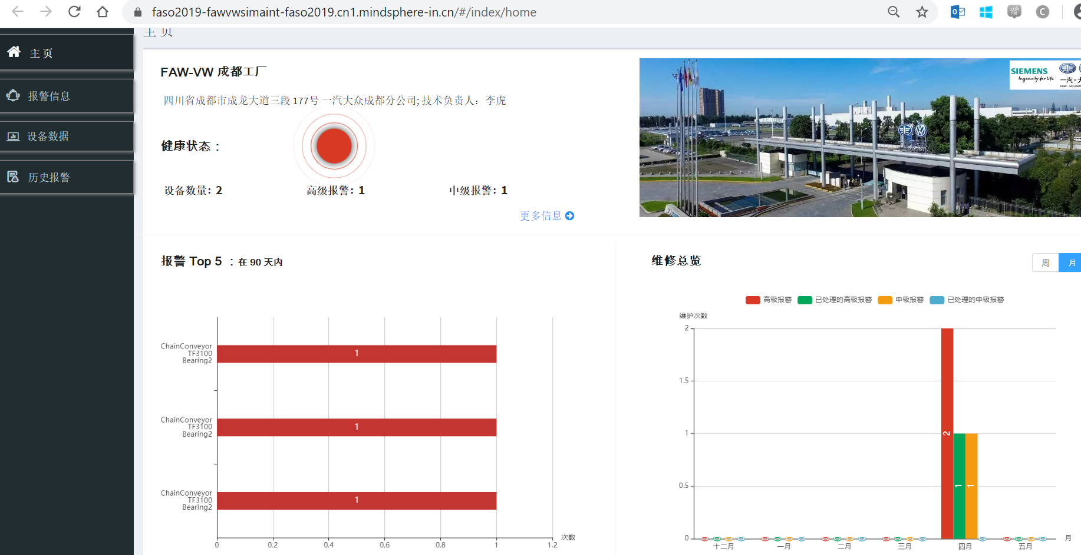
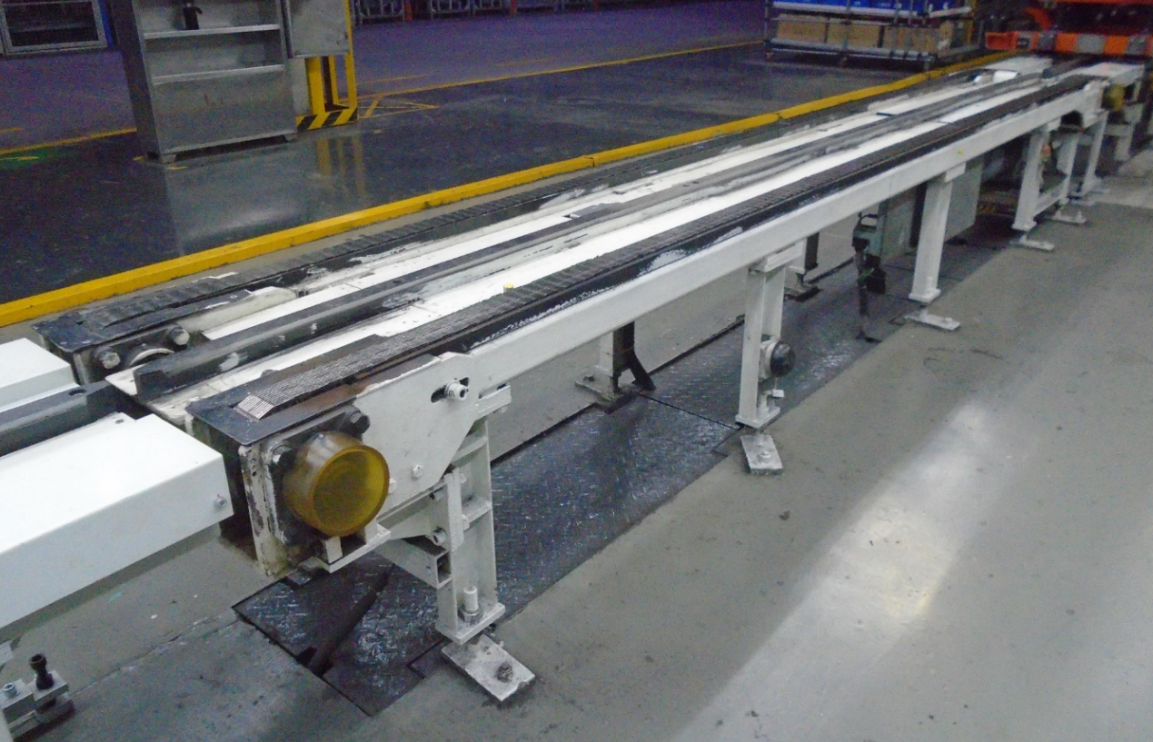
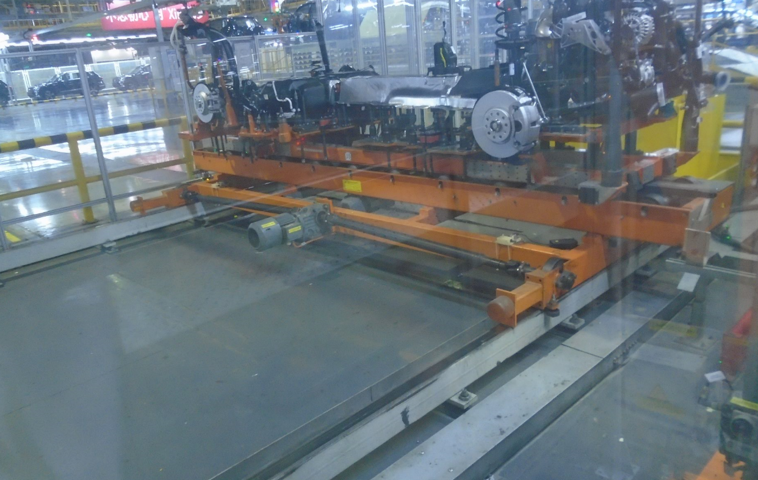
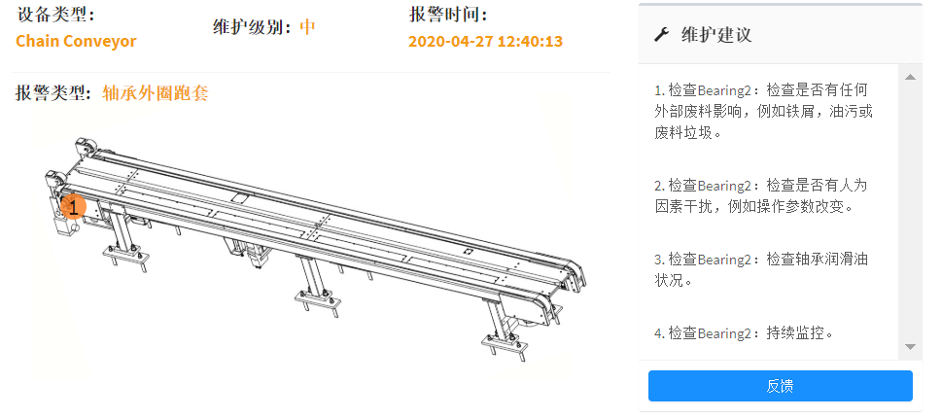
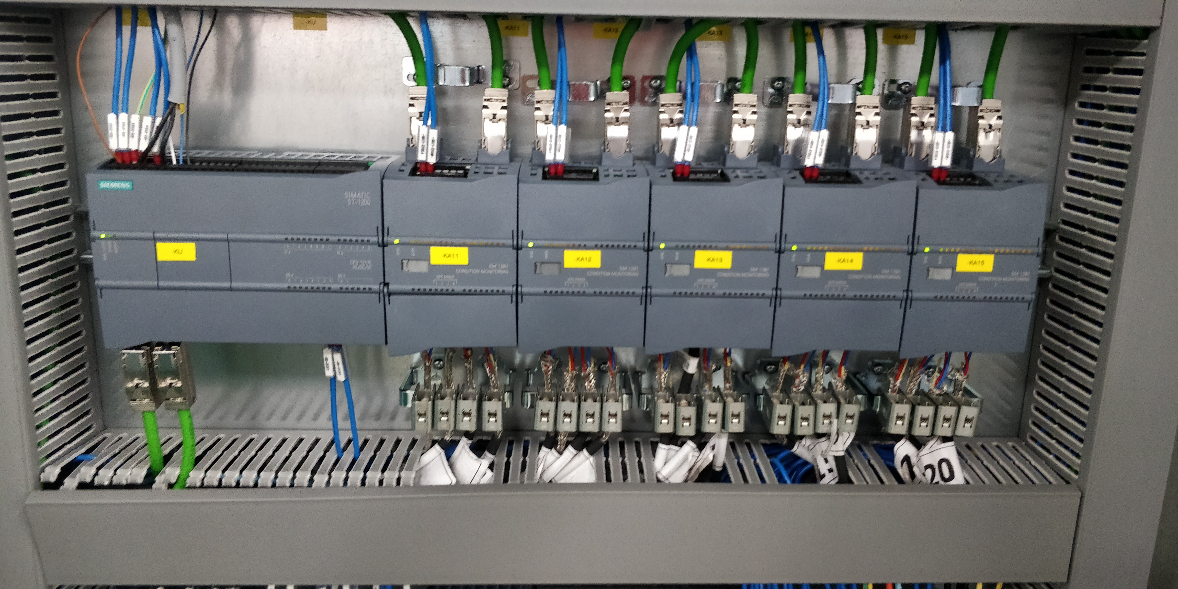
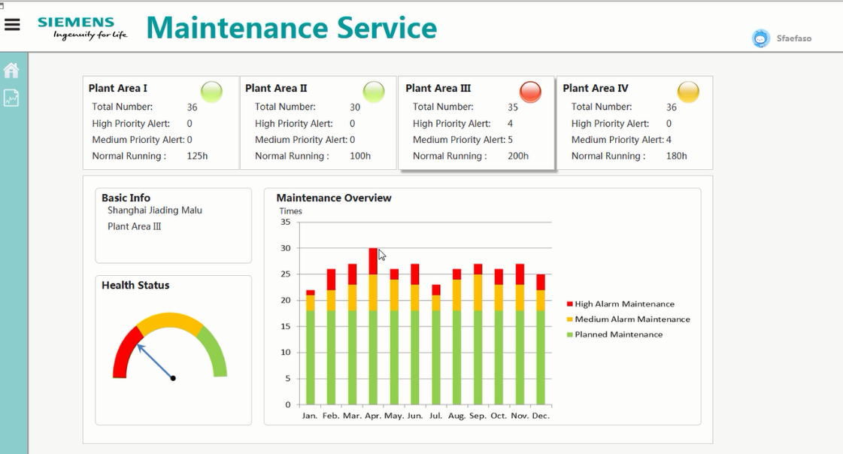
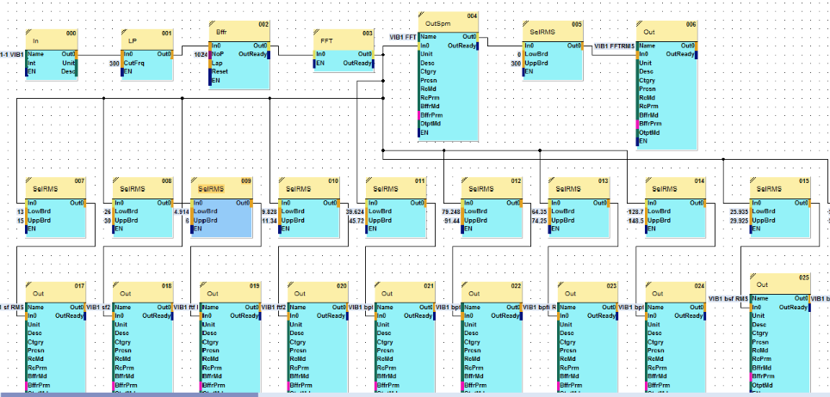
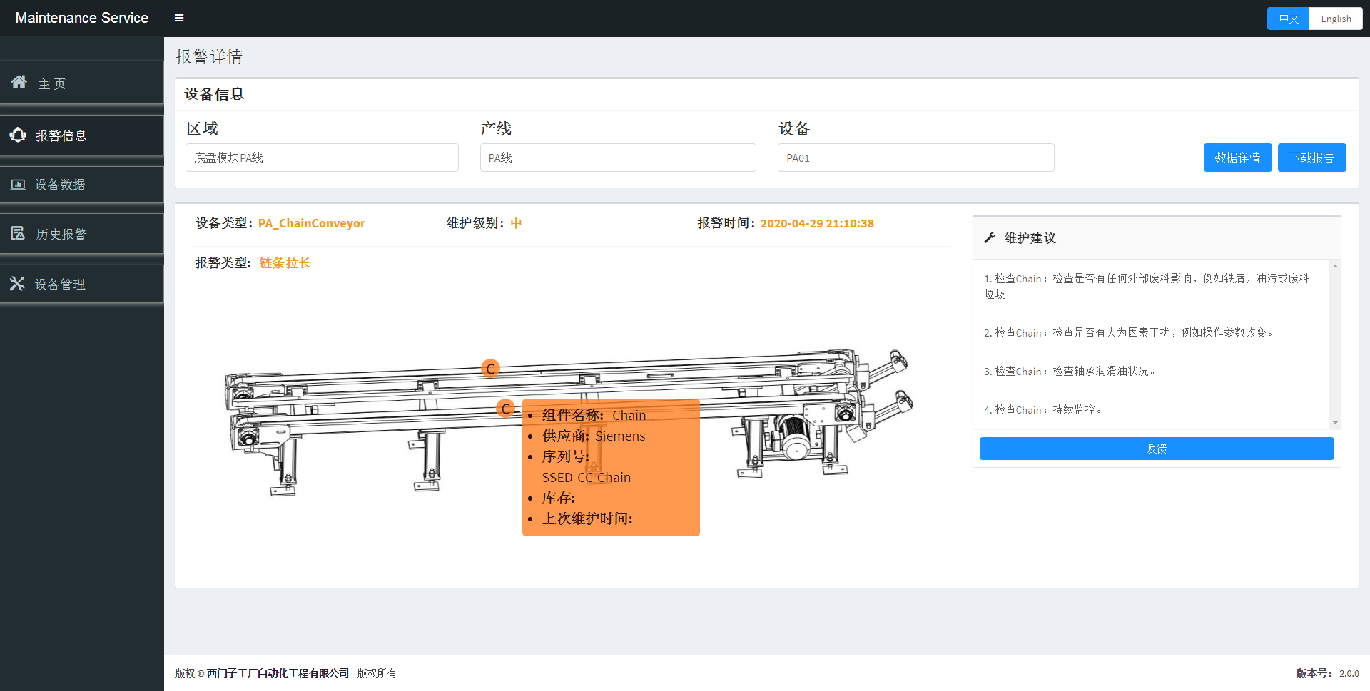
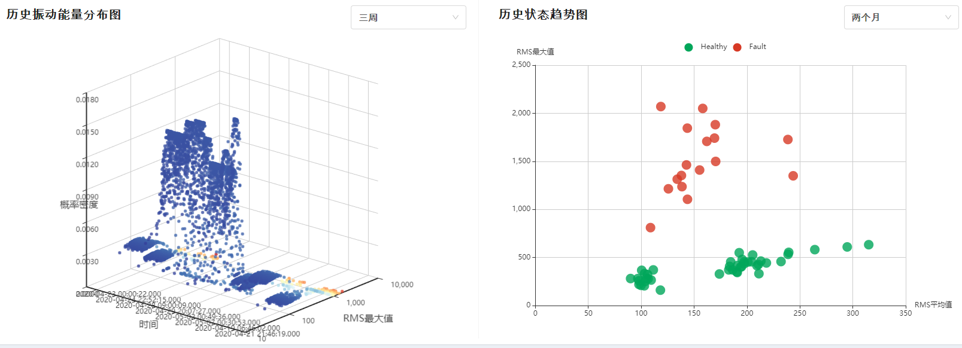
Extension of DaaS
Pilot project
Device as a Sevice (DaaS) on FAW-VW Chengdu(￥0.6‘)
Marriage line(shaft) data acquisition and edge computing
MindSphere solution, deliver MindApp
Customer factory setup and deployment
Implementation project
Device as a Sevice (DaaS) on SAIC-VW CP3 Shanghai(￥0.8‘)
Assembly Line, Marriage Line Chain Conveyor, Bodyshop Lifter data acquisition and edge computing
Multi-sensor solution comparison
Local server solution
Customer factory setup and deployment
Follow up project
Device as a Sevice (DaaS) Mindsphere R&D Project(￥1‘)
Maintanence MindApp development
AGV data acquisition and edge computing
Experience center setup and deployment
1st project
“Aiways” Lifter Mindsphere R&D Project (￥0.7‘)
Lifter data acquisition
Edge computing on vibration analysis
Data transmission to MindSphere
MindAPP system design
Aug. 2018
Jun. 2019
Dec. 2019
July. 2020

Slide 11
Continuously development of technology in DaaS
Device Type
Multi-type AGV data acquisition and edge computing
Multi-protocol data acquisition
Edge computing by self-develop module, embedded into IoT2040
Data transfer to MindSphere by OEDK
Basic framework and maintenance MindApp Development
Chain Conveyor of assembly line data acquisition and edge computing
Local version big data storage (TimeScale DB)
Combined analysis in frequency domain and time domain
Edge analysis configuration tool design (Electron)
Wechat Mini-program (communication with MindSphere)
DA Solution
Root cause analysis of production bottleneck, combined with maintenance alarm and SiPlant operation system data.
OPC of Industry Edge solution integration
Edge Computing
Data Integration
Service Model and Performance
Aug, 2018
Dec, 2019
July, 2020
June, 2019
March, 2020
Now
End of line data acquisition solution
Performance and computing module optimization
Add label for data sample
Data export function tool for on-site engineer
Integrated with end-customer IT system
HighSpeed Lifter data acquisition
Edge computing on vibration analysis (X-tools)
Data transmission to MindSphere (MindConnect Nano)
MindAPP system design
Maintenance knowledge graph (blazegraph) in MindSphere
Local version solution design
Experience center setup and deployment
Continuous technology upgrade

Slide 12
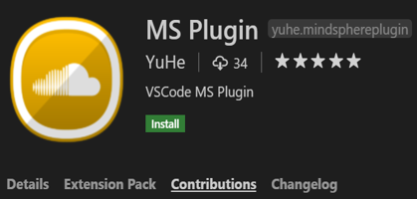
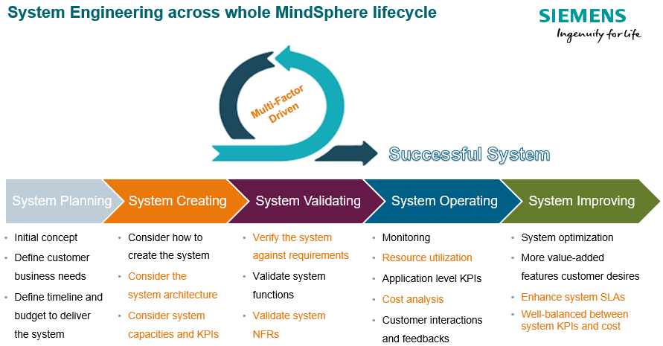
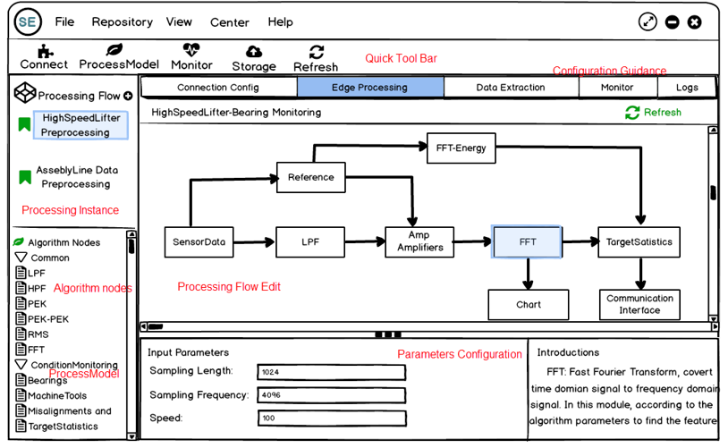
Promotion between innovation and practical projects
MindSphere VSCode Plugin
Tool to make development and deployment of MindApp more acceptable and productive.
Support MindSphere consulting and training projects.
BU：MindSphere R&D and Sales.
CloudSim
Provide a generalized, extensible simulation framework, evaluation of resource allocation policy in virtual environment, find performance bottleneck.
Support “Standard services model for one MindSphere”.
BU：MindSphere R&D CN.
Projects Practice
Easy to Use Edge Computing Tool
Integrated domain knowhow for automotive edge computing, incl. device, DA model and processing module.
Support DaaS solution promotion, save engineering effort.
BU：DI CS SFAE FASO.
Requirements Driven
Innovation Topics Development

Slide 13
Summary
Growth Path：
2020 ~
Easy to use, easy to integrate industry Collaborative IoT solutions
Low effort and threshold building blocks for digital business
Outlook
2017--2020
Projects: End-to-end IoT projects
Device condition monitoring
- Schaeffler (DF PL CAS)
- THVS (SE GP T NP BIC THVS)
DaaS (Maintenance Service)
- SAIC VW, FAW-VW (DI CS SFAE FA-SO)
- WaterWheelStation Digital (RC-CN DI S-RE SE&TSS)
Device reverse control based on cloud
- SmartWaterManagement (DI CS DE&DS CAS)
Innovation Topics:
Low-effort Engineering
- Data Feeding Module
- MindSphere VSCode Plugin
Resource and performance optimization
- CloudSim
- Easy to use edge computing tools
Innovation Projects
2015--2017
Cloud + Automation
MindKnowledge Project
BU : DI SW CAS (MindSphere HQ)
Training for MindSphere R&D CN Setup
BU: DI SW CAS
Consulting for MindSphere Domestic Solution
BU: DI SW GS&CS AP CN, DI DE
Support from colleagues and families

Slide 14
Questions?
Answers!

Slide 15
Thank you for your attention
YU He Lead Engineer Corporate Technology
200, Linghu Avenue 214135, Wuxi China
Mobile: +86 18921506861
E-mail: yu-he@siemens.com
siemens.com

